Slide 1


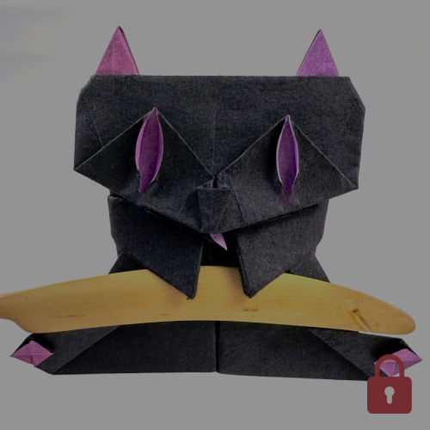
Origami Hub
Welcome To My Website!

Slide 2
Overview:
Origami Hub is a modern and creative digital platform dedicated to the art of origami and paper crafts. The website is designed to inspire creativity by providing users with easy-to-follow tutorials, innovative paper-folding techniques, and visually engaging content.
From beginners taking their first steps into origami to experienced creators exploring advanced designs, Origami Hub offers structured guidance for every skill level.

Slide 3
About Me:
Origami Hub is a creative platform dedicated to the art of paper folding. Our goal is to inspire learners of all ages by providing easy tutorials, clear diagrams, and engaging content. We promote creativity, patience, and imagination through simple and advanced origami designs.

Slide 4
Community Section
User-Friendly Interface
A space for users to share and connect.
The website's design ensures easy navigation for all users.
We share easy tutorials, clear diagrams, and creative ideas to help beginners and learners improve their origami skills.
Diagrams
Tutorials
Detailed illustrations of origami models.
Step-by-step guides for learning origami techniques.
Videos
Visual demonstrations of origami folding processes.

Slide 5
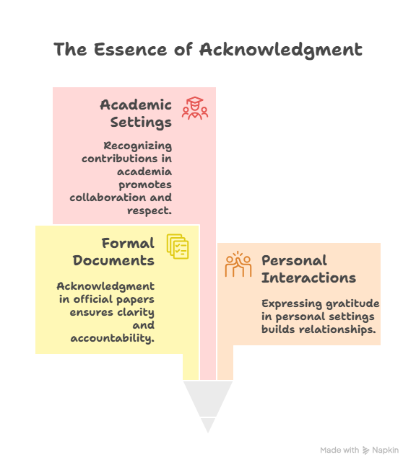
Acknowledgment
I would like to express my sincere gratitude to my teacher for guidance and encouragement throughout this project. I am also thankful to my institute for providing learning resources. Special thanks to my family and friends for their continuous support, motivation, and valuable feedback during the development of the Origami Hub website.

Slide 6
Synopsis
"Origami Hub is a creative platform dedicated to the art of paper folding. It offers step-by-step tutorials, inspiring DIY projects, and a community for enthusiasts to share ideas. Whether you are a beginner or an experienced folder, Origami Hub provides all the resources and guidance to explore, learn, and create stunning origami designs effortlessly."
Stakeholder Alignment
Effective Communication
Ensuring all parties are informed and agree
Facilitating clear and concise information exchange
Methodologies
The approaches and techniques used in the project
Expected Outcomes
The anticipated results and deliverables of the project
Scope
The boundaries and extent of the project
Significance
The importance and impact of the project
Objectives
The goals the project aims to achieve

Slide 7
Origami Hub is a creative and educational platform designed for origami lovers of all ages. The website focuses on teaching the art of paper folding in a simple and engaging way. It provides step-by-step tutorials that help beginners learn origami with ease. Advanced users can explore complex designs and innovative folding techniques. Origami Hub also shares creative DIY ideas to boost imagination and creativity. The platform encourages learning through visuals, guides, and clear instructions. Users can discover new patterns, shapes, and artistic concepts regularly.

Slide 8
Analysis
The analysis of the Origami Hub website focuses on usability, design, and content quality. The platform is structured to provide easy navigation, clear tutorials, and engaging visuals. It effectively supports creativity, learning, and user interaction through a simple, responsive, and well-organized interface.

Slide 9
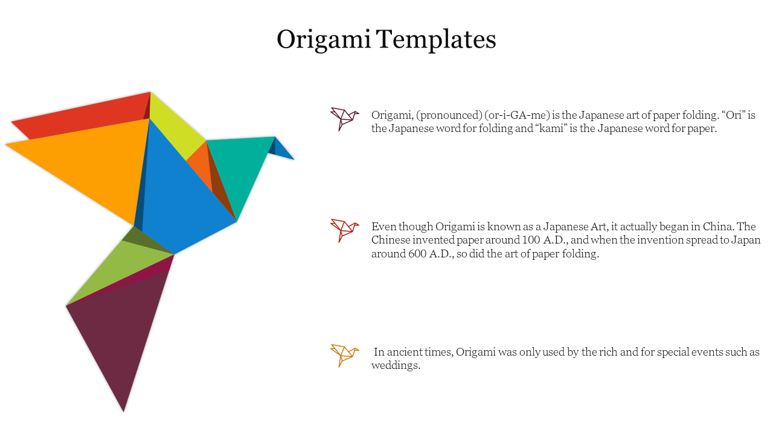
The analysis of the Origami Hub website shows a strong focus on creativity, usability, and learning efficiency. The website structure is simple and well-organized, making navigation easy for users. Clear categories, visual tutorials, and responsive design enhance the overall user experience.

Slide 10
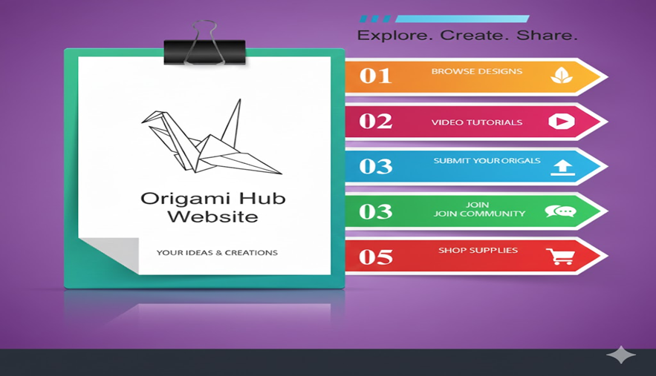
Project Design
The Origami Hub website is designed with a modern, clean, and user-friendly interface. The layout focuses on smooth navigation, attractive color schemes, and responsive design. Clear sections, visual elements, and structured content enhance user experience and make browsing, learning, and purchasing origami products easy and engaging.

Slide 11
The design emphasizes smooth navigation, responsive layout, and visually appealing color schemes. Well-organized sections, clear typography, and graphical elements improve usability and provide an engaging and professional user experience across all devices.

Slide 12
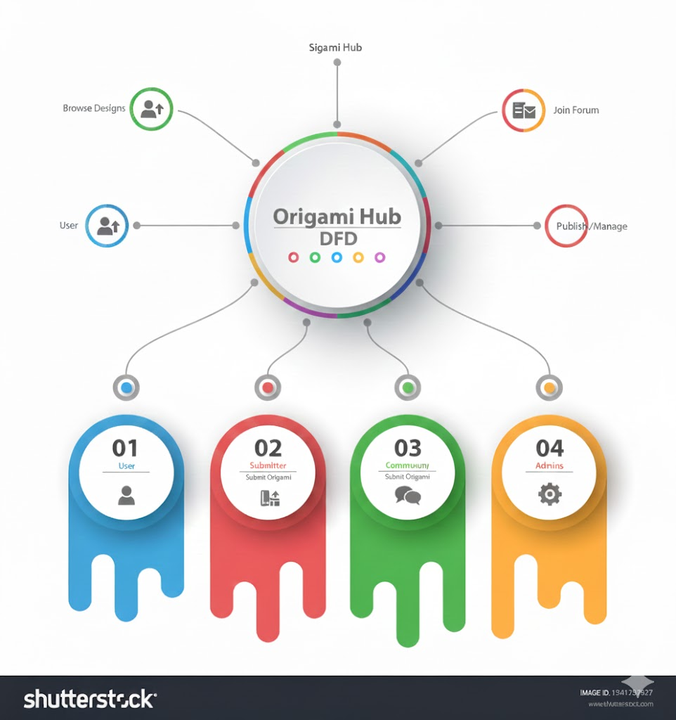
DFD’s
The Data Flow Diagram of the Origami Hub website illustrates how user data flows through the system. It shows interactions between users, processes, and the database, including browsing products, submitting inquiries, and placing orders, ensuring accurate data handling and smooth system operations.

Slide 13
The DFD also represents backend processes such as user authentication, order management, and content updates. It helps in understanding how information is processed, stored, and retrieved efficiently, making the website reliable, organized, and easy to manage from both user and admin perspectives.

Slide 14
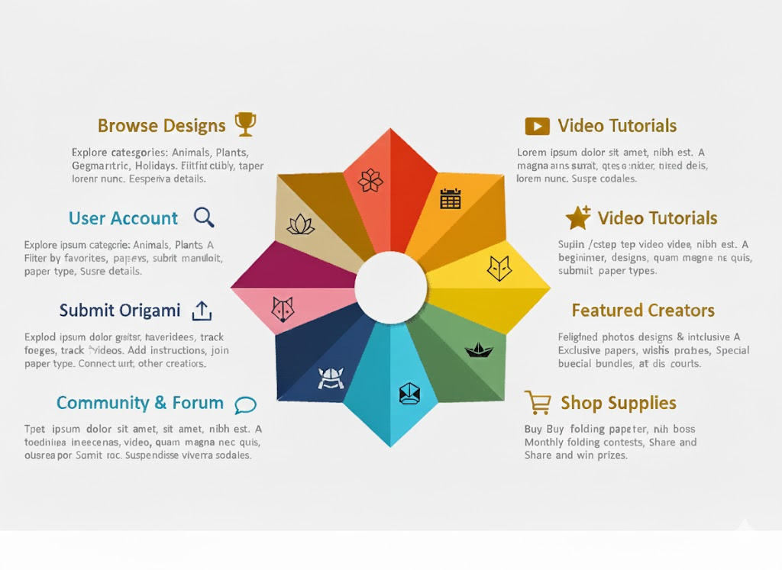
Flow Chart

Slide 15
The flowchart of the Origami Hub website represents the step-by-step flow of user activities within the system. It shows how users navigate from the homepage to browsing origami products, viewing details, and submitting orders or inquiries, ensuring a smooth and logical process flow.
The flowchart also highlights decision points such as user login, product selection, and order confirmation. This visual representation helps in understanding system functionality, improves clarity of operations, and supports efficient website management and user interaction.

Slide 16
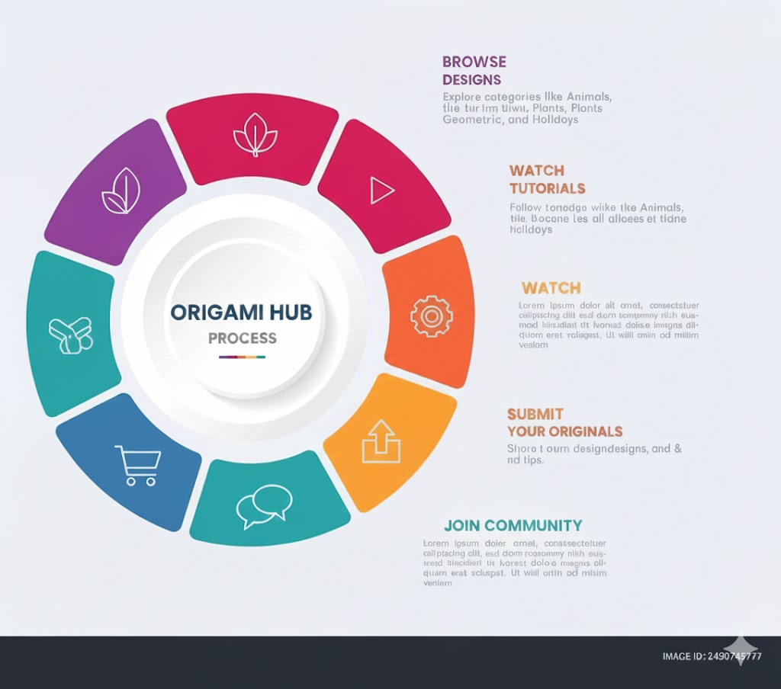
Process Diagram

Slide 17
The process diagram of the Origami Hub website illustrates the complete workflow of system operations. It shows how user requests are received, processed, and converted into actions such as product browsing, order placement, and inquiry submission, ensuring smooth coordination between frontend and backend processes.

Slide 18
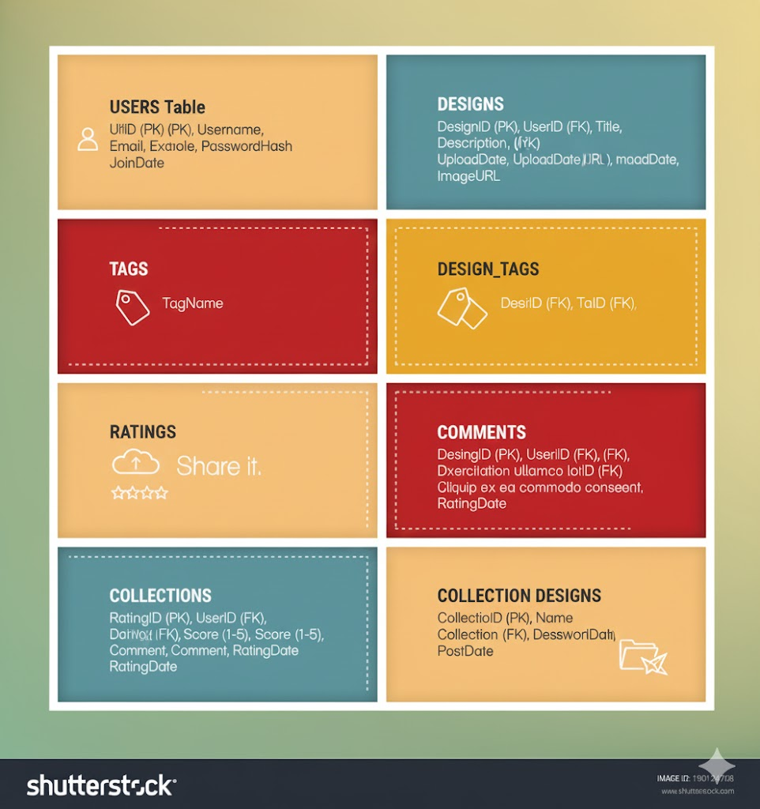
Database Design/Structure
The database design structure of the Origami Hub website organizes all system data in a structured and efficient manner. It includes tables for users, products, categories, orders, and inquiries, ensuring accurate data storage, easy retrieval, and data consistency across the website.

Slide 19
The database structure also supports secure user authentication and smooth order management. Proper relationships between tables improve system performance, reduce data redundancy, and make the website scalable, reliable, and easy to maintain for future enhancements

Slide 20
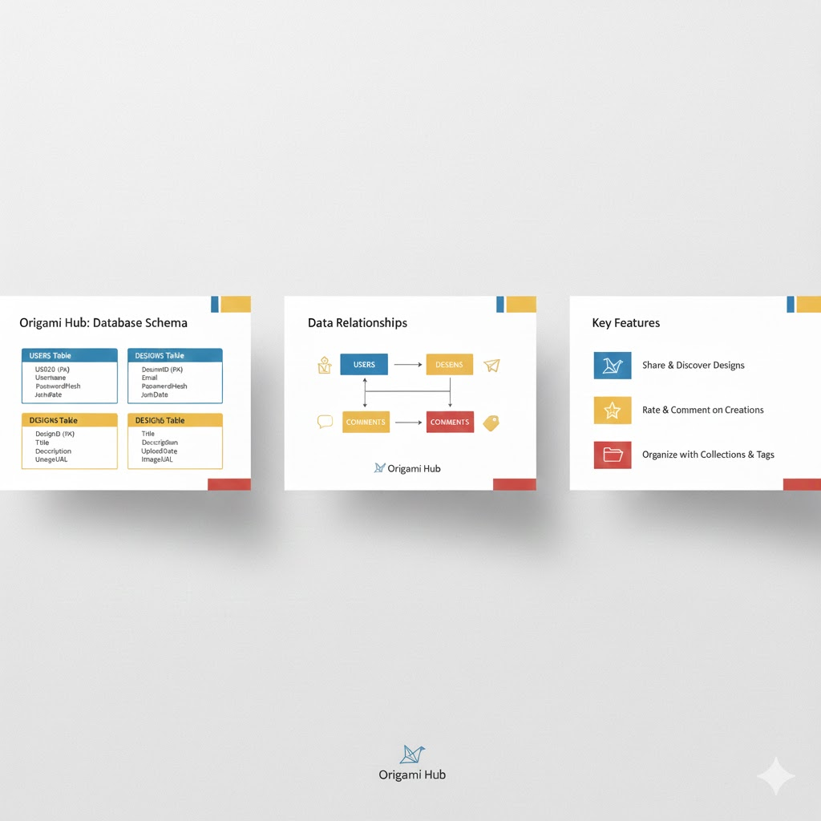
Screen Shot’s

Slide 21
The screenshots of the Origami Hub website visually demonstrate the overall design, layout, and functionality of the system. They highlight key pages such as the homepage, product listings, and detailed views, showing how content is organized and presented to users.

Slide 22

Source Code With Comment

Slide 23
The source code of the Origami Hub website is written in a well-structured and organized manner with proper comments. These comments explain the purpose of each section, function, and logic, making the code easy to understand, maintain, and modify for future development.

Slide 24
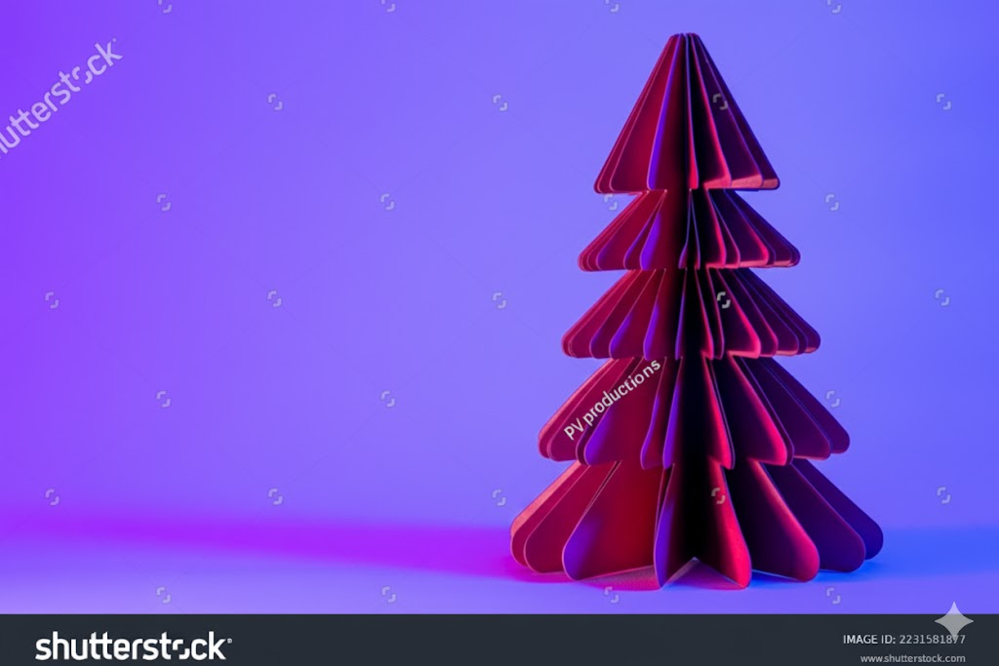
Conclusion
The Origami Hub website is a complete and well-structured project that combines attractive design with efficient functionality. It provides a user-friendly platform for exploring origami products and information. The project successfully demonstrates practical web development skills, system design, and effective data management.

Slide 25
Thank You ! For Visiting My Website
Made By:
Zainab Naseem
Hassan Gull
Ayesha Behram
Sohera
Muhammed Tayyab Tahir

